Slide 1
Quickly Build Analyst NLP Capability in Your Organization
MAJ John Scudder
AORS 2023

Slide 2




Motivation
NLP permeates our daily lives
How can you quickly learn and leverage NLP for your own use cases?
My Goal: Equip you with a framework and resources to bring NLP capability to analysts in your organization.

Slide 3
Agenda
Background
Methodology: Environment / Audience Considerations
Lesson Plan
Best Practices
Resources for YOU!
Curated opensource resources
Code repository with Jupyter Notebooks and slides

Slide 4
Background

Slide 5

Background
Problem set within USMA D/Math:
Existing research projects have a requirement to analyze unstructured text data → NLP knowledge
All D/Math Faculty have experience with w/ structured data
~5 members w/ NLP experience out of > 90 faculty
Solution: Combine local experience & offer 5x interactive lectures w/ runnable code
I’m providing you the product we used → tailor it for your purposes!

Slide 6
Methodology

Slide 7




Environment
Requirements
Collaborative coding environment
Common Python packages installed
Classroom for instruction
Possible Solutions
CoCalc
Google Colab
Institutional Compute Cluster
Cloud-based (e.g., AWS, Azure)

Slide 8
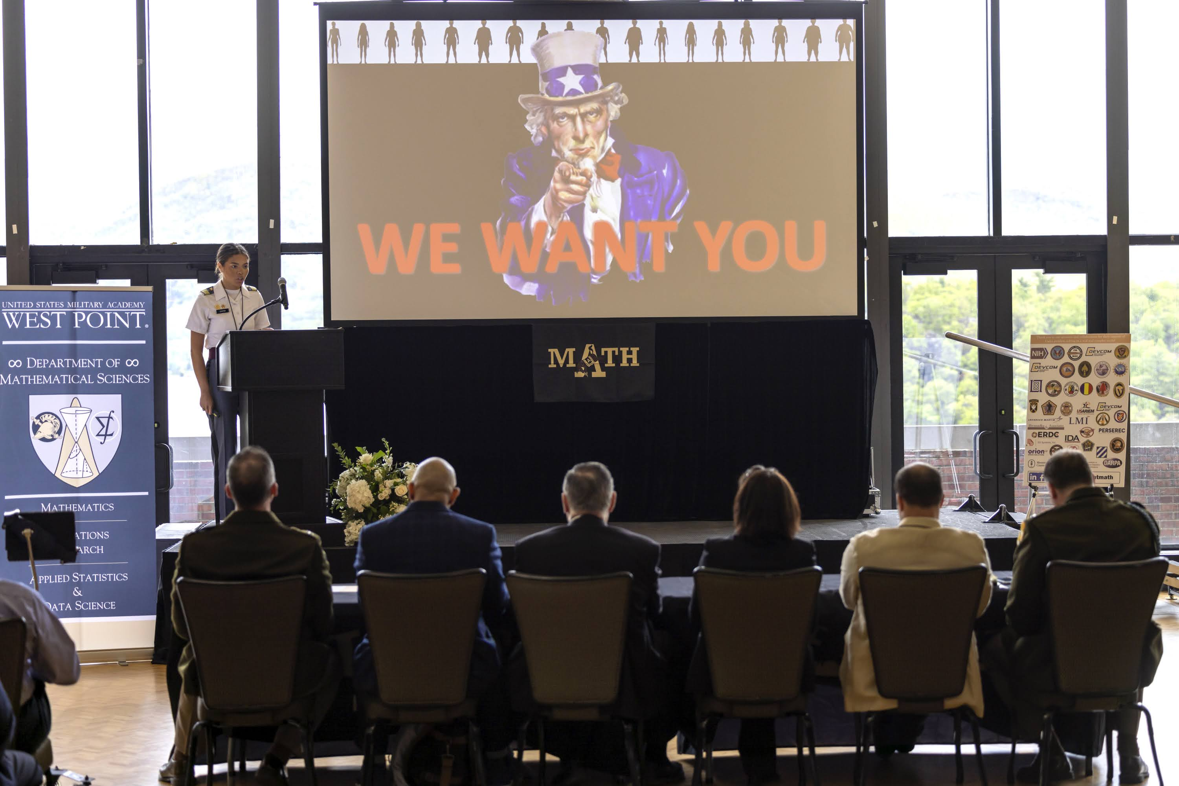
Audience
D/Math Population
Experienced Analysts / Researchers
Range of Python skills
Method of Instruction
Demos and slides
Executable code to discuss
Jupyter Notebooks
Common dataset to our organization: course-end feedback

Slide 9
Lesson Plan

Slide 10
5x Lesson Agenda
Lesson Plan
NLP Tasks & Terminology; Preprocessing
Basic Lexical Analysis & Word Representations
Word Embeddings & Model Training
SOTA models & Python Packages (Hugging Face)
Additional packages & Ongoing Research in Department

Slide 11
Lesson 1:
NLP Tasks & Terminology;
Preprocessing

Slide 12
Lesson 1: NLP Tasks & Terminology; Preprocessing
Common NLP Tasks
Syntax
Semantics
Morphology
Word Segmentation
Part-of-Speech Tagging
Parsing
Constituency
Dependency
Sentiment Analysis
Topic Modelling
Named Entity Recognition (NER)
Relation Extraction
Word Sense Disambiguation
Natural Language Understanding (NLU)
Natural Language Generation (NLG)
Machine Translation
Entailment
Question Answering
Language Modelling
Discourse
Summarization
Coreference Resolution
Adapted from Chris Tanner’s CS287 Lecture Slides.

Slide 13


Lesson 1: NLP Tasks & Terminology; Preprocessing
Common NLP Tasks
Syntax
Semantics
Morphology
Word Segmentation
Part-of-Speech Tagging
Parsing
Constituency
Dependency
Sentiment Analysis
Topic Modelling
Named Entity Recognition (NER)
Relation Extraction
Word Sense Disambiguation
Natural Language Understanding (NLU)
Natural Language Generation (NLG)
Machine Translation
Entailment
Question Answering
Language Modelling
Really slow wait. Took forever to get food.
Freshest ingredients ever. New favorite restaurant. Will be back!
Found a hair in the food. Horrible.
Waited 6 months to get a reservation at this place. Totally worth it.
Discourse
Summarization
Coreference Resolution
Adapted from Chris Tanner’s CS287 Lecture Slides.

Slide 14
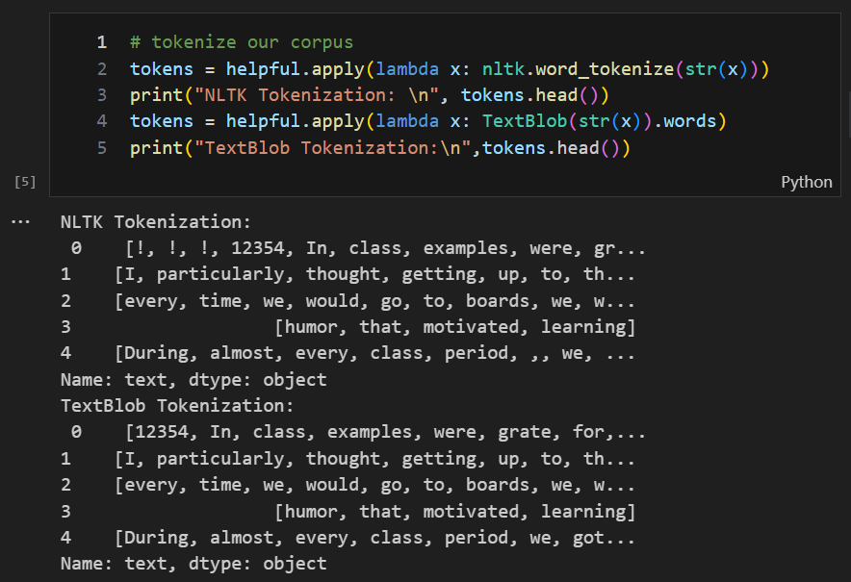
Lesson 1: NLP Tasks & Terminology; Preprocessing
Tokenization
“I particularly thought getting up to the boards was helpful.”
→ [I, particularly, thought, getting, up, to, ...]

Slide 15
Lesson 2:
Basic Lexical Analysis & Word Representations

Slide 16
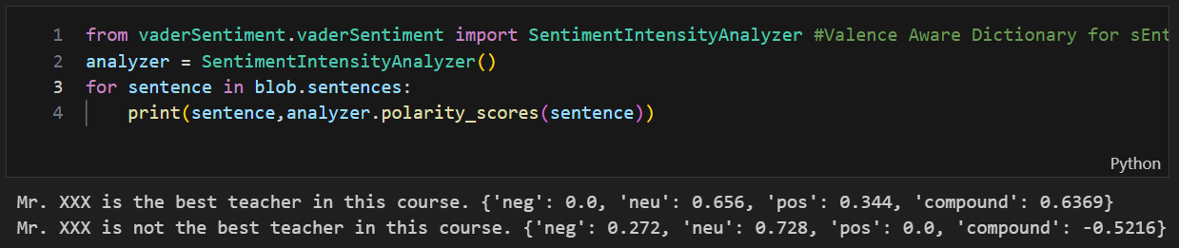
Lesson 2: Basic Analysis and Word Representations
Basic Sentiment Analysis
“Mr. XXX is the best teacher in this course.”
{'neg': 0.0, 'neu': 0.656, 'pos': 0.344, 'compound': 0.6369}
“Mr. XXX is not the best teacher in this course.”
→ {'neg': 0.272, 'neu': 0.728, 'pos': 0.0, 'compound': -0.5216}

Slide 17
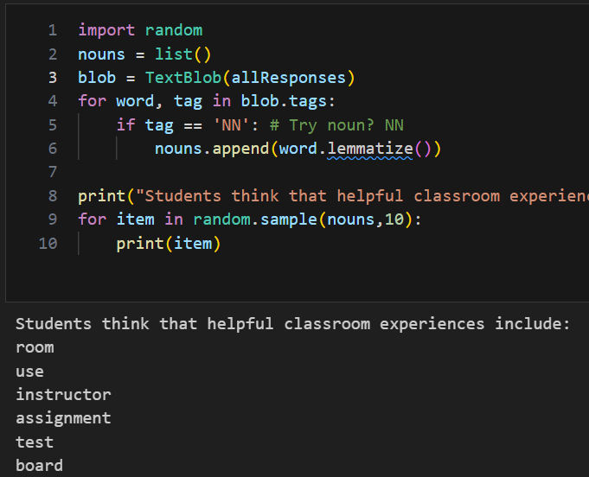
Lesson 2: Basic Analysis and Word Representations
Simplistic Summarization: Keywords
What do students think the most helpful classroom experiences include?

Slide 18
Lesson 3:
Word Embeddings & Model Training

Slide 19
Lesson 3: Word Embeddings & Model Training
Task: find similar comments based on cosine similarity of word2vec embeddings
Input: doing practice problems and having class examples were very helpful

Slide 20
Lesson 3: Word Embeddings & Model Training
Input: doing practice problems and having class examples were very helpful
**** word2vec Recommendations ****
the various class practice problems were especially helpful
doing problems in class was very helpful for my learning
this path course offered a lot of opportunities to go to the boards during class and practice class examples this was extremely helpful to not only practice problems but to also have the instructor critique our work
doing board problems were very helpful
working through problems as a class was very helpful to me

Slide 21
Lesson 4:
SOTA Models & Python Packages

Slide 22
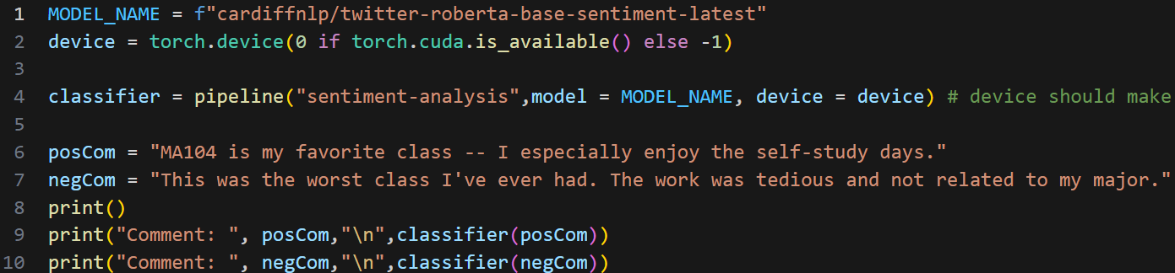
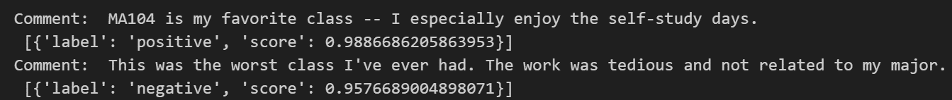
Lesson 4: SOTA Models & Hugging Face Tools
Sentiment Analysis with a Pre-Trained LLM (SOTA)

Slide 23
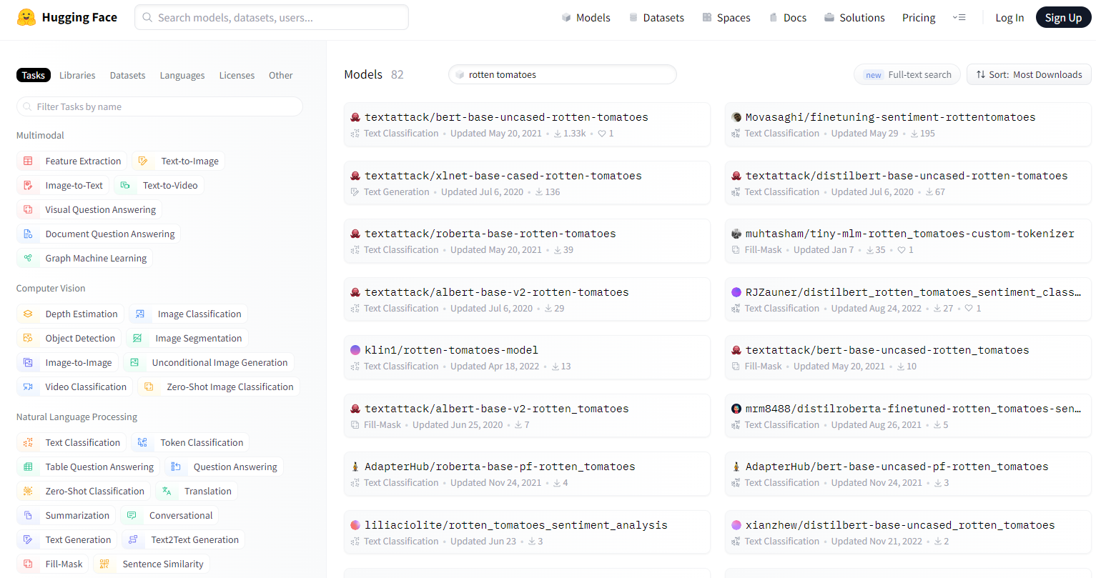
Lesson 4: SOTA Models & Hugging Face Tools
Where do I get SOTA models? Benchmark datasets?
Model Hub: https://huggingface.co/models

Slide 24
Lesson 5:
Additional Packages & Ongoing Research in Department

Slide 25
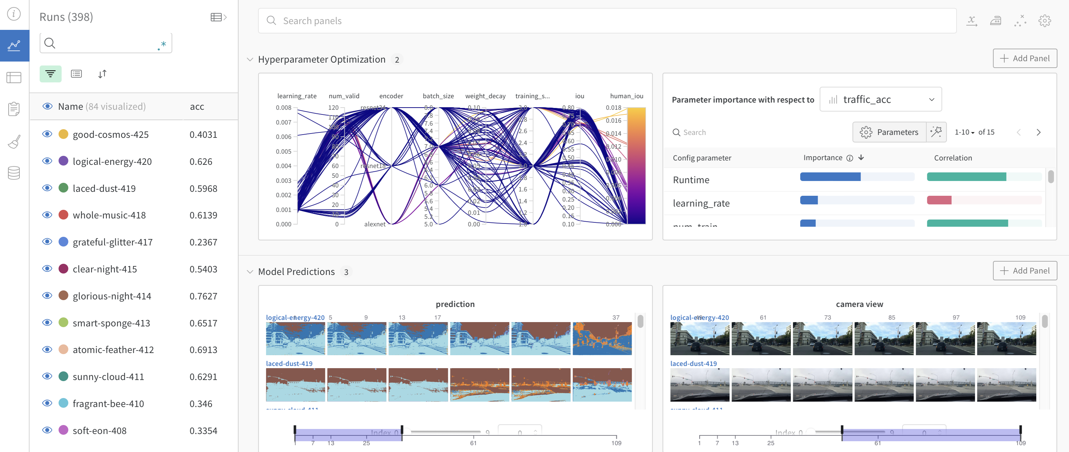
Lesson 5: Packages & Ongoing Research
Why use Weights & Biases? It automates your record keeping!
W&B Docs | Weights & Biases Documentation (wandb.ai)
Intro_to_Weights_&_Biases.ipynb - Colaboratory (google.com)

Slide 26

Lesson 5: Packages & Ongoing Research
Why use Label Studio? It’s an intuitive environment to label data!
Open Source Data Labeling | Label Studio

Slide 27
Best Practices

Slide 28
Best Practices
Use a dataset familiar for your faculty
Consider audience coding skills and desired coding environment
Include orientation to using Graphics Processing Units (GPUs) for large language models (LLM)
Provide executable code – live coding is slow

Slide 29
What are your next steps?

Slide 30
Resources for YOU

Slide 31
Curated Open-Source Resources
The Hugging Face community (particularly their Transformers library) is one of the most popular communities/platforms for NLP/AI/ML. They have great tutorials and readable documentation. Hugging Face models and datasets are designed to work well with and/or build on other popular NLP packages [nltk, AllenNLP, spacy].
CS287: Deep Learning for NLP is a course I took in grad school. It was only taught for one semester, but the lecture slides are all available online (for now) [link - scroll to "Lectures"]. There’s also a Supplemental Resources page for NLP.
If you want straightforward explanations of how the most used NLP models work, Jay Alammar has a blog with great visuals and explanations for word2vec (2013) and BERT (2018+) toward the bottom of his blog posts.
Sebastian Ruder [his site] [his Google Scholar] has a great blog that covers new ideas in NLP, NLP Progress, his highlights from NLP conferences…etc. In 2018 he gave a brief timeline of NLP. https://ruder.io/a-review-of-the-recent-history-of-nlp/.

Slide 32

Questions?
Scan QR code for GitHub repository access!
Email: john.scudder@westpoint.edu

Slide 34
Backup Slides

Slide 35
5x Lesson Agenda
15 March @ 1500 in TH120
Preprocessing, Tokenization, Part of Speech Tagging
22 March @ 1000 in TH120
Basic lexical analysis – sentiment, cosine similarity
Representations – N-Grams, Bag of Words
5 April @ 1100 in TH120
TF-IDF & word2vec
Visualizations
Training models
19 April @ 1000 in TH120
State-of-the-art models: transformers, BERT
Hugging Face packages
9 May @ 1000 in TH120
2x packages: Weights & Biases + Label Studio
Hone your craft! Ongoing D/Math research with NLP

Slide 36
LESSON 1

Slide 37
Common Tasks

Slide 38
Common Tasks (aka problems)
Syntax
Semantics
Morphology
Word Segmentation
Part-of-Speech Tagging
Parsing
Constituency
Dependency
Sentiment Analysis
Topic Modelling
Named Entity Recognition (NER)
Relation Extraction
Word Sense Disambiguation
Natural Language Understanding (NLU)
Natural Language Generation (NLG)
Machine Translation
Entailment
Question Answering
Language Modelling
Discourse
Summarization
Coreference Resolution
Adapted from Chris Tanner’s CS287 Lecture Slides.
Notes:
Why is it challenging?
Computers don’t process information in the same way as humans. For example, when we read the sentence “I am hungry,” we can easily understand its meaning.
Similarly, given two sentences such as “I am hungry” and “I am sad,” we’re able to easily determine how similar they are. For machine learning (ML) models, such tasks are more difficult.
Refer to these as “downstream tasks.”

Slide 39

Common Tasks (aka problems)
Syntax
Semantics
Morphology
Word Segmentation
Part-of-Speech Tagging
Parsing
Constituency
Dependency
Sentiment Analysis
Topic Modelling
Named Entity Recognition (NER)
Relation Extraction
Word Sense Disambiguation
Natural Language Understanding (NLU)
Natural Language Generation (NLG)
Machine Translation
Entailment
Question Answering
Language Modelling
“The U.S. secretly modified the Himars rocket launchers it gave Ukraine to keep Kyiv from firing missiles into Russia.”
Discourse
Summarization
Coreference Resolution
Adapted from Chris Tanner’s CS287 Lecture Slides.

Slide 40
Common Tasks (aka problems)
Syntax
Semantics
Morphology
Word Segmentation
Part-of-Speech Tagging
Parsing
Constituency
Dependency
Sentiment Analysis
Topic Modelling
Named Entity Recognition (NER)
Relation Extraction
Word Sense Disambiguation
Natural Language Understanding (NLU)
Natural Language Generation (NLG)
Machine Translation
Entailment
Question Answering
Language Modelling
Really slow wait. Took forever to get food.
Freshest ingredients ever. New favorite restaurant. Will be back!
Found a hair in the food. Horrible.
Waited 6 months to get a reservation at this place. Totally worth it.
Discourse
Summarization
Coreference Resolution
Adapted from Chris Tanner’s CS287 Lecture Slides.

Slide 41
Common Tasks (aka problems)
Syntax
Semantics
Morphology
Word Segmentation
Part-of-Speech Tagging
Parsing
Constituency
Dependency
Sentiment Analysis
Topic Modelling
Named Entity Recognition (NER)
Relation Extraction
Word Sense Disambiguation
Natural Language Understanding (NLU)
Natural Language Generation (NLG)
Machine Translation
Entailment
Question Answering
Language Modelling
Discourse
sports
news
politics
fashion
Summarization
Coreference Resolution
Adapted from Chris Tanner’s CS287 Lecture Slides.

Slide 42
Common Tasks (aka problems)
Syntax
Semantics
“Alexa, play White Christmas by Bing Crosby”
Sentiment Analysis
Topic Modelling
Named Entity Recognition (NER)
Relation Extraction
Word Sense Disambiguation
Natural Language Understanding (NLU)
Natural Language Generation (NLG)
Machine Translation
Entailment
Question Answering
Language Modelling
Morphology
Word Segmentation
Part-of-Speech Tagging
Parsing
Constituency
Dependency
“Alexa, play White Christmas by Bing Crosby”
INTENT
SONG
ARTIST
Discourse
Summarization
Coreference Resolution
Adapted from Chris Tanner’s CS287 Lecture Slides.

Slide 43
Common Tasks (aka problems)
Syntax
Semantics
Morphology
Word Segmentation
Part-of-Speech Tagging
Parsing
Constituency
Dependency
Sentiment Analysis
Topic Modelling
Named Entity Recognition (NER)
Relation Extraction
Word Sense Disambiguation
Natural Language Understanding (NLU)
Natural Language Generation (NLG)
Machine Translation
Entailment
Question Answering
Language Modelling
Dzień dobry
Good morning
POLISH
ENGLISH
Discourse
Summarization
Coreference Resolution
Adapted from Chris Tanner’s CS287 Lecture Slides.

Slide 44
Hands-on Coding

Slide 45
LESSON 2

Slide 46
Terminology

Slide 47
Representations
How do we get any system to process, “understand”, leverage language?
Representation: how we transform symbolic meaning (e.g., words, signs, braille, speech audio) into something the computer can use
Modelling: given these represented symbols, how we use them to model the task at hand
Adapted from Chris Tanner’s CS287 Lecture Slides.

Slide 48
Representations
Representing images is relatively easy. There is a meaningful relationship between the byte values and color.
170
33
71
255
33
71
r
g
b
r
g
b
Adapted from Chris Tanner’s CS287 Lecture Slides.

Slide 49
Representations
In contrast – words are represented by strings and there are no meaningful relationships between the byte values and language.
h
a
t
e
a
t
e
68
61
74
65
61
74
65
hate and ate. No relation but similar byte values.
H
a
t
h
a
t
48
61
74
68
61
74
Hat and hat. Identical concept but different byte values.
Adapted from Chris Tanner’s CS287 Lecture Slides.

Slide 50


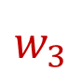
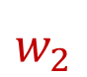

Language Modeling
A Language Model estimates the probability of any sequence of words
Let $X$ = “Jack was late for class”
$$w_{1}$$
$$w_{2}$$
$$w_{3}$$
$$w_{4}$$
$$w_{5}$$
$P(X)$ = $P$(“Jack was late for class”) = $2.3 x {10}^{−14}$
Adapted from Chris Tanner’s CS287 Lecture Slides.

Slide 51

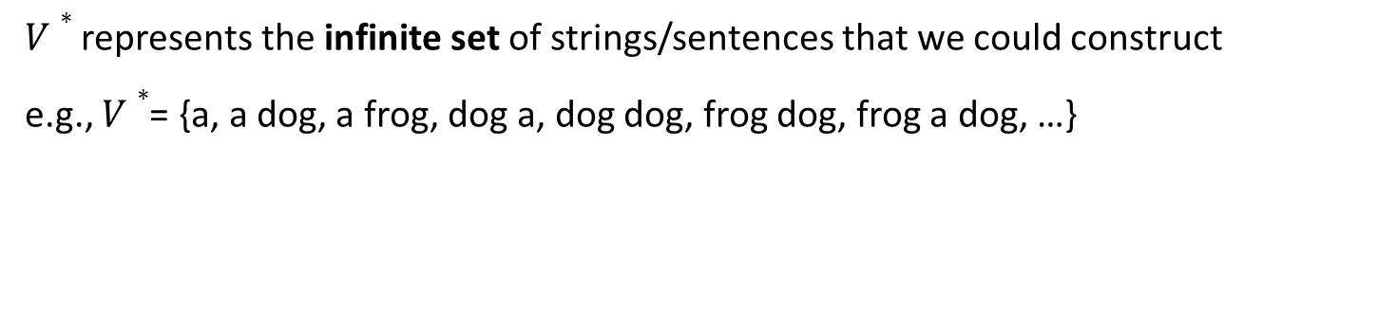
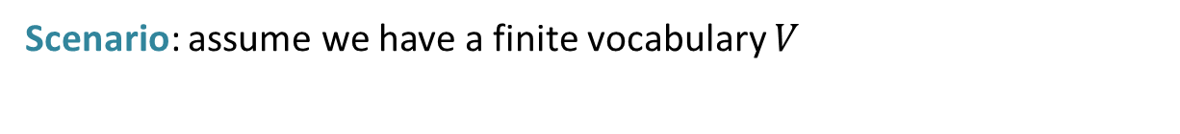

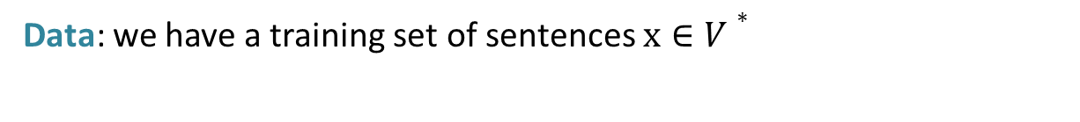
Language Modeling
Scenario: assume we have a finite vocabulary $V$
$V∗$represents the infinite set of strings/sentences that we could construct
e.g., $V∗$= {a, a dog, a frog, dog a, dog dog, frog dog, frog a dog, …}
Data: we have a training set of sentences $x∈V∗$
Problem: estimate a probability distribution:
$$p\left(the\right)={10}^{−2}$$
$$\sum_{x∈V∗}{p\left(x\right)}=1$$
$$p\left(the, sun, okay\right)=2.5x{10}^{−13}$$
$$p\left(waterfall,the,icecream\right)=3.2x{10}^{−18}$$
Adapted from Chris Tanner’s CS287 Lecture Slides.

Slide 52
Token vs. Type
A word token is a specific occurrence of a word in a text
A word type refers to the general form of the word, defined by its lexical representation
If our corpus were just “I ran and ran and ran”, you’d say we have:
6x word tokens [I, ran , and , ran , and , ran]
3x word types: {I, ran, and}
Adapted from Chris Tanner’s CS287 Lecture Slides.

Slide 53

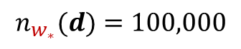
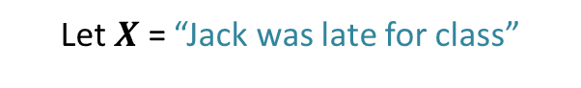
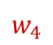
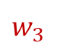
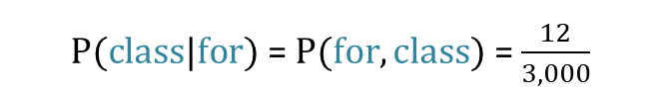
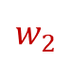
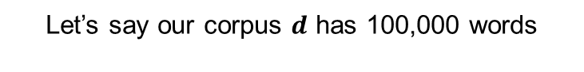
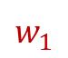
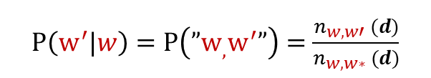
N-Grams
Bigram Model Example – condition each word on its immediate predecessor
Let’s say our corpus $d$ has 100,000 words
Let $X$ = “Jack was late for class”
$$w_{1}$$
$$w_{2}$$
$$w_{3}$$
$$w_{4}$$
$$w_{5}$$
word | # occurrences
Jack | 15
was | 1,000
late | 400
for | 3,000
class | 350
$P\left(w^{′}|w\right)=P\left(”w_{,}w^{′}”\right)=$ $\frac{n_{{w,w′}_{ }}(d)}{n_{{w,w∗}_{ }}(d)}$
$P(class|for)$ = $P(for, class)$ = $\frac{12}{3,000}$
$$n_{w_{∗}}(d)=100,000$$
$n_{{w,w′}_{ }}(d$) = # of times words $w$and $w′$appear together as a bigram in $d$
$n_{w,w∗}(d)$ = # of times word $w$ is the first token of a bigram in $d$
Adapted from Chris Tanner’s CS287 Lecture Slides.
Notes:
Google Books Ngram Viewer
https://books.google.com/ngrams/graph?content=laptop+computer&year_start=1985&year_end=2008&corpus=en-2009&smoothing=2&case_insensitive=true

Slide 54
Bag of Words
Simple idea: let’s represent each document as a feature vector, which can serve as the input to any of your favorite supervised ML models
Let’s say our dataset’s entire vocabulary is just 10 words. Each unique word can have its own dimension (feature index). Each document’s vector has a 1 if the word is present. Otherwise, 0.
e.g., “the dog jumped” is represented as
dog
the
quick
went
brown
a
jumped
fast
over
store
[ 1 1 0 0 0 0 1 0 0 0 ]
Adapted from Chris Tanner’s CS287 Lecture Slides.
Notes:
One-hot encoding

Slide 55
Bag of Words
baseball
chicago
cubs
the
wringley
padres
shohei
mvp
homerun
crowd
Imagine a document is a sports broadcast transcript, which concerns a few teams but mostly discusses the local home team, the Cubs. We have no indication of how much the document is about the Cubs.
[ 1 1 1 1 0 1 0 0 0 1 ]
baseball
chicago
cubs
the
wringley
padres
shohei
mvp
homerun
crowd
Using a count-based approach, now we can see that it’s much more about the
Chicago Cubs than the Padres.
[ 2 9 17 8 0 2 0 0 0 2 ]
Adapted from Chris Tanner’s CS287 Lecture Slides.

Slide 56
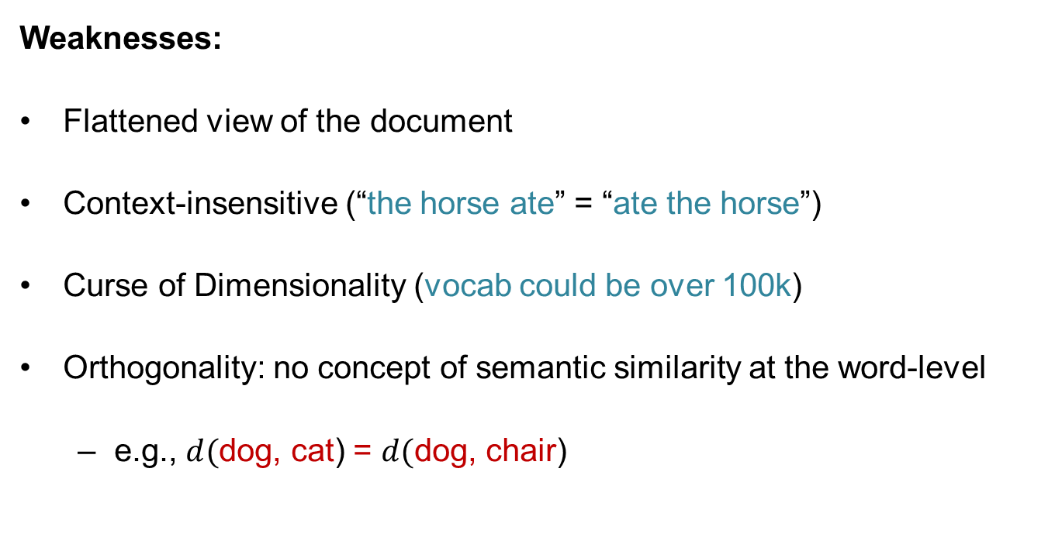
Bag of Words
Weaknesses:
Flattened view of the document
Context-insensitive (“the horse ate” = “ate the horse”)
Curse of Dimensionality (vocab could be over 100k)
Orthogonality: no concept of semantic similarity at the word-level
e.g., $d($dog, cat) = $d($dog, chair)
Adapted from Chris Tanner’s CS287 Lecture Slides.

Slide 57
Hands-on Coding

Slide 58
LESSON 3

Slide 59
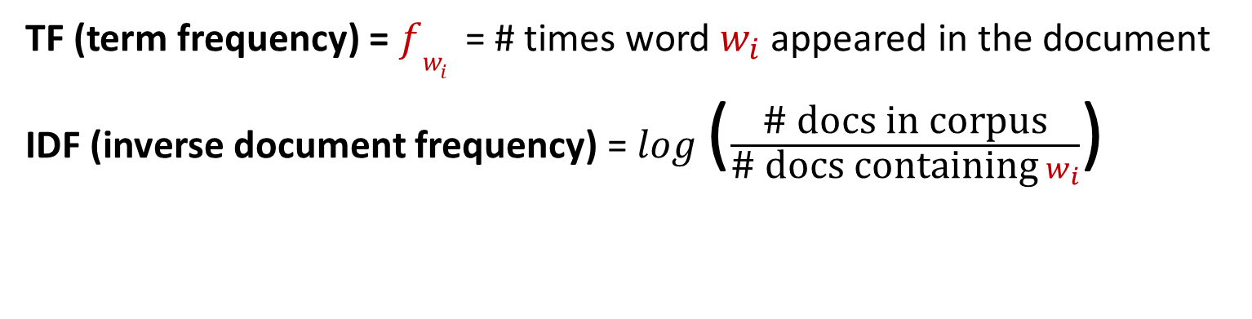
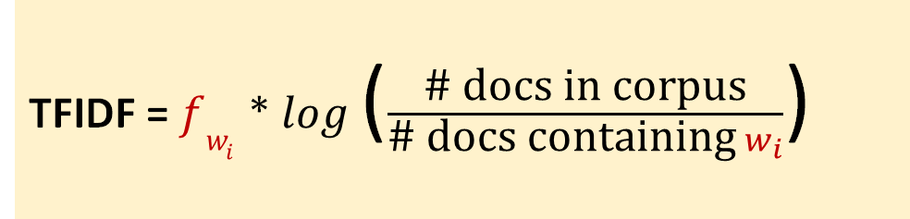
TF-IDF
TF (term frequency) = $fw_{i}$ = # times word $w_{i}$ appeared in the document
IDF (inverse document frequency) = $log⁡$($\frac{\text{\# }\text{docs} \text{in} \text{corpus}}{\text{\# }\text{docs} \text{containing}{ w}_{i}}$)
TFIDF = $fw_{i}$ * $log⁡$($\frac{\text{\# }\text{docs} \text{in} \text{corpus}}{\text{\# }\text{docs} \text{containing}{ w}_{i}}$)
TF-IDF rewards “rare” words that frequently appear in a few documents. Words that appear in every document in the corpus have a TF-IDF score = 0.
Hans Peter Luhn (1957) credited with TF; Karen Spärck Jones (1972) credited with IDF.
Adapted from Chris Tanner’s CS287 Lecture Slides.
Notes:
Term Weighting Approaches in Automatic Text Retrieval
https://en.wikipedia.org/wiki/Tf%E2%80%93idf#References
https://en.wikipedia.org/wiki/Tf%E2%80%93idf#Motivations
There isn’t much theoretical justification for IDF.

Slide 60
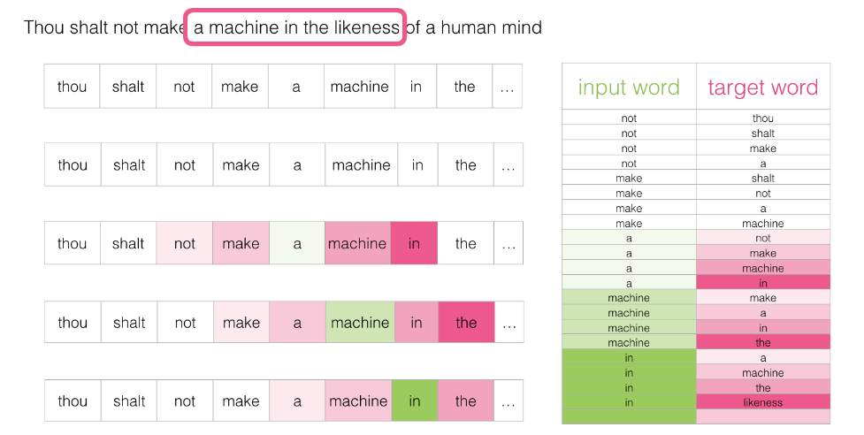
Word2Vec
Graphic:
https://jalammar.github.io/illustrated-word2vec/
Original Papers:
https://arxiv.org/abs/1301.3781
https://arxiv.org/abs/1309.4168

Slide 61
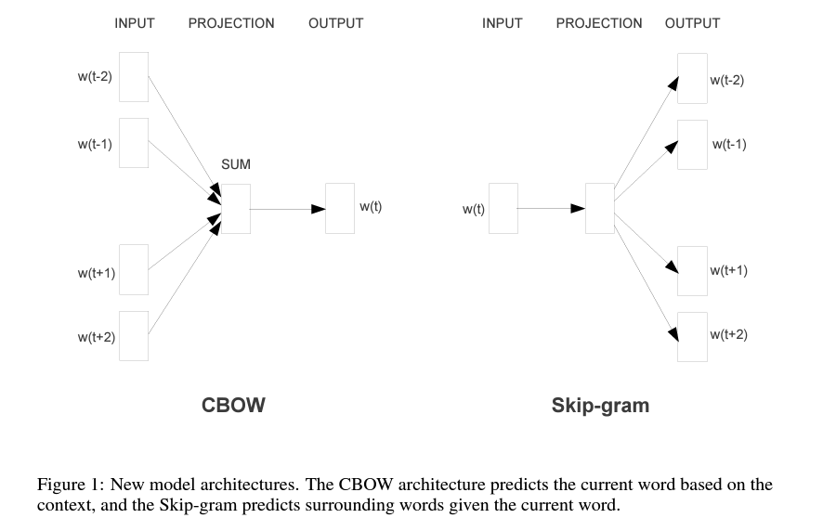
Word2Vec
Original Papers:
https://arxiv.org/abs/1301.3781
https://arxiv.org/abs/1309.4168
Notes:
https://israelg99.github.io/2017-03-23-Word2Vec-Explained/
Continuous Bag-of-Words (CBOW)
CBOW predicts target words (e.g. ‘mat’) from the surrounding context words (‘the cat sits on the’). Statistically, it has the effect that CBOW smoothes over a lot of the distributional information (by treating an entire context as one observation). For the most part, this turns out to be a useful thing for smaller datasets.
Skip-Gram
Skip-gram predicts surrounding context words from the target words (inverse of CBOW). Statistically, skip-gram treats each context-target pair as a new observation, and this tends to do better when we have larger datasets.

Slide 62
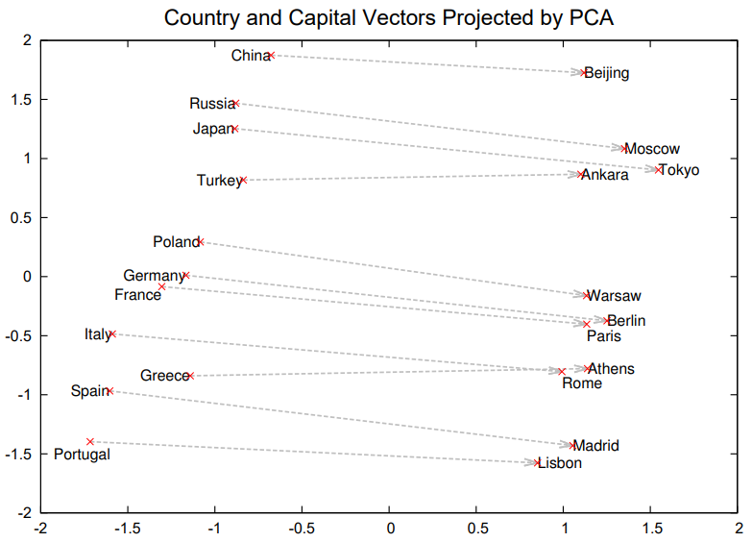
Word2Vec
Original Papers:
https://arxiv.org/abs/1301.3781
https://arxiv.org/abs/1309.4168
https://arxiv.org/abs/1310.4546
Notes:
[Figure Caption] Two-dimensional PCA projection of the 1000-dimensional Skip-gram vectors of countries and their capital cities. The figure illustrates ability of the model to automatically organize concepts and learn implicitly the relationships between them, as during the training we did not provide any supervised information about what a capital city means.

Slide 63
Word2Vec
Document 1 | Document Vector Embedding ---> | 0.4, -0.0375, 0.725, ...
Word Embedding | the | 0.4, 0.25, 0.1, …
Word Embedding | board | 0.9, -0.42, 0.01, ...
Word Embedding | was | 0.6, 0.34, -0.21, ...
Word Embedding | great | -.3, -0.32, 3, ...
Document 2 | Document Vector Embedding ---> | 0.285, 0.23, -0.34, ...
Word Embedding | the | 0.4, 0.25, 0.1, …
Word Embedding | elephant | 0.34, 0.23, -0.3, ...
Word Embedding | was | 0.6, 0.34, -0.21, ...
Word Embedding | big | -0.2, 0.1, 0.07, ...
Notes:
https://colab.research.google.com/drive/1u2gHoVS7n80MsvMHJSQygyWjJsf2V1D3?usp=sharing
https://jalammar.github.io/illustrated-word2vec/

Slide 64
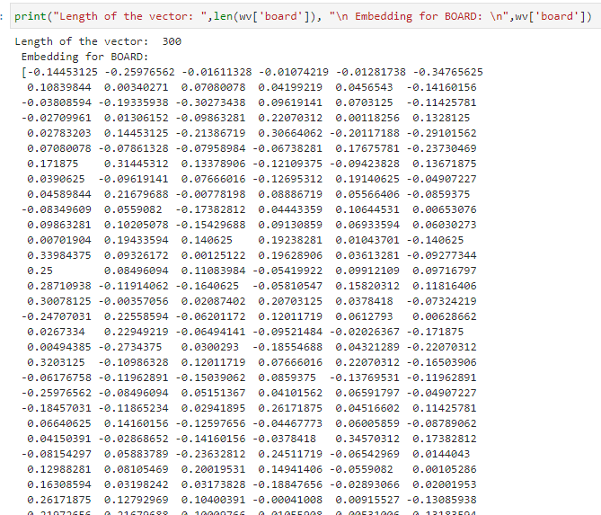
Word2Vec

Slide 65
Hands-on Coding
Notes:
Word2Vec:
https://code.google.com/archive/p/word2vec/
https://jalammar.github.io/illustrated-word2vec/#:~:text=Word2vec%20is%20a%20method%20to,commercial%2C%20non%2Dlanguage%20tasks.
https://github.com/RaRe-Technologies/gensim/blob/develop/gensim/models/word2vec.py

Slide 66
LESSON 4
Link to Behemoth Google Colab Notebook!
Separate Notebooks for Exploring vs. Training a Model
Part 1: Explore Hugging Face Datasets and Models
Part 2: Train a Model

Slide 67
Transformers
…and BERT

Slide 68

Transformers – The BIG deal…
Transformers are an architecture that enables accurate and efficient transfer learning
Keeps track ONLY of model weights, biases, configuration
Customizable
Encoder / Decoder
Encoder (extract meaning of input – all at once):
Document classification
Named entity recognition
Extractive Q&A
Ex: BERT (Bidirectional Encoder Representations from Transformers)
Decoder (access meaning of input – sequential):
Next word prediction
Text Generation
Encoder / Decoder (extract features, then produce sequential output):
Text Summarization
Translation

Slide 69
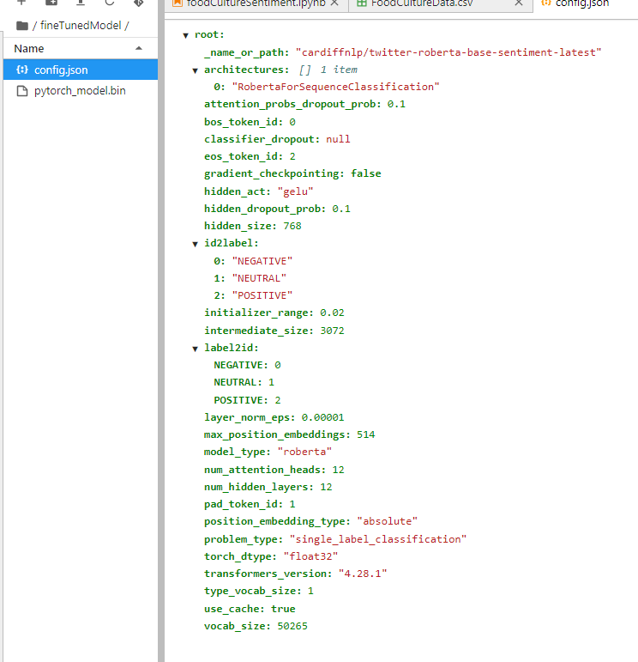
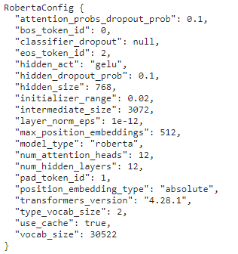
What do Transformers keep track of?

Slide 70
Why is this nice?
Common Architecture / Ecosystem enables transfer learning
“Reuse a pre-trained model as the starting point for a model on an adjacent task” – Layman’s Terms
Repurposing on a related task is MUCH quicker
Most language models begin with an MLM, trained at GREAT expense… then add a classifier.
MLMs vary based on tokenizers (BPE vs. WordPiece) and architecture (number of hidden layers, size of hidden layers, etc.)
You can even repurpose repurposed models (what we’ll do today)
Model Hub: https://huggingface.co/models

Slide 71
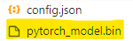
A look at BERT Base (110M parameters)
Up to 512 tokens per sample
Input Embedding (vocab size x embedding dim) 30522 x 768 + others = 24M
12 Layers: 7.1M x 12 = 85M
“Attention Head”: 7.1M
Output Layer: 0.5M
Computing Parameters - Stack Overflow

Slide 72
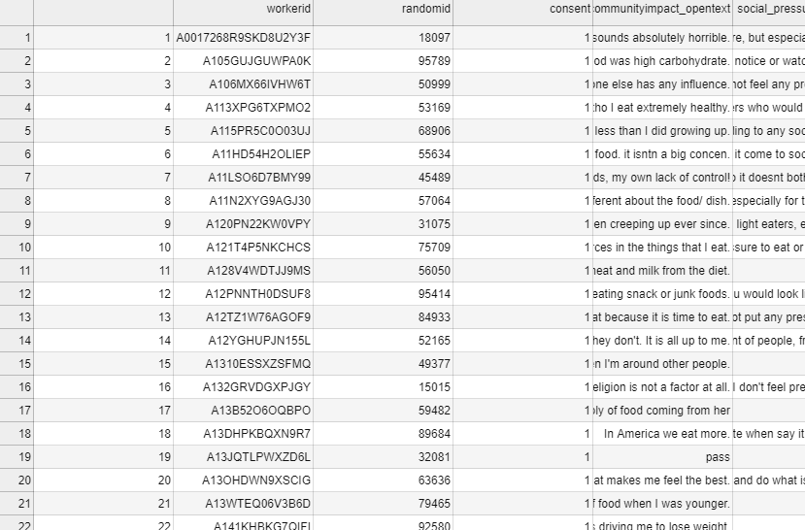
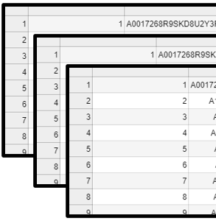

Batches, Samples, and Epochs,
Oh, my!
Samples
“Rows of data”
documents or records – not tokens
Batches
Enables efficient parallelism
Batch Size = Samples / Batches
Updates model weights each batch
Epochs
How many times should the model see all data?
Forward / Backward pass

Slide 73
Embedding Differences

Slide 74
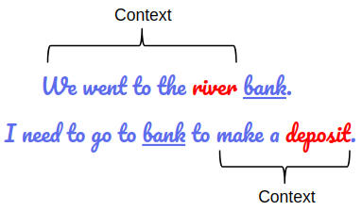
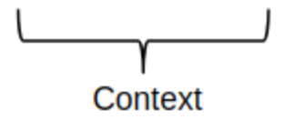
Word Embeddings vs. Contextualized Embeddings
word embeddings: words have the same vector representation regardless of context.
contextualized embeddings: words have a different vector representation dependent on their context
Word2Vec: 'bank' vector is the same
[river] bank [financial] bank
BERT: 'bank' vector is different.
[river] bank [financial] bank
Analytics Vidhya: Demistifying BERT.
Notes:
Another important concept to understand is word embeddings and how they differ from contextualized word embeddings
These are concise definitions for the purpose of understanding this idea.
word embeddings: words have the same vector representation regardless of context.
Contextualized embeddings: words have a different vector representation dependent on their context
An example is below. On the BOTTOM LEFT we see two sentences.
On the BOTTOM RIGHT we see that two models, word2vec and GloVe, are models with word embeddings and the vectors would be the same regardless of context
Two other models, ELMo and BERT, which use contextualized word embeddings would have different representations for bank dependent on context.
OPTIONALLY:
word2vec pre-trained on a Google News Corpus of ~ 100B words.
I will refer to contextualized distributed representations as contextualized word embeddings
In 2013-2014, the papers introducing word2vec and GloVe (Global Vectors for Word Representation) were published.

Slide 75
Text Processing Pipeline

Slide 76
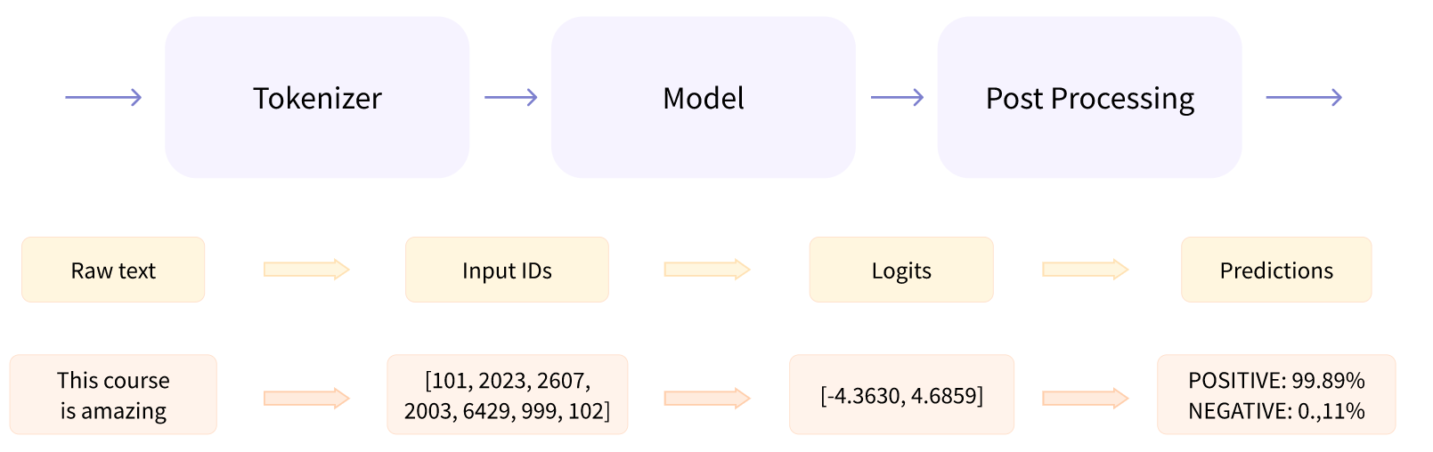
General Pipeline
Behind the pipeline - Hugging Face Course

Slide 77
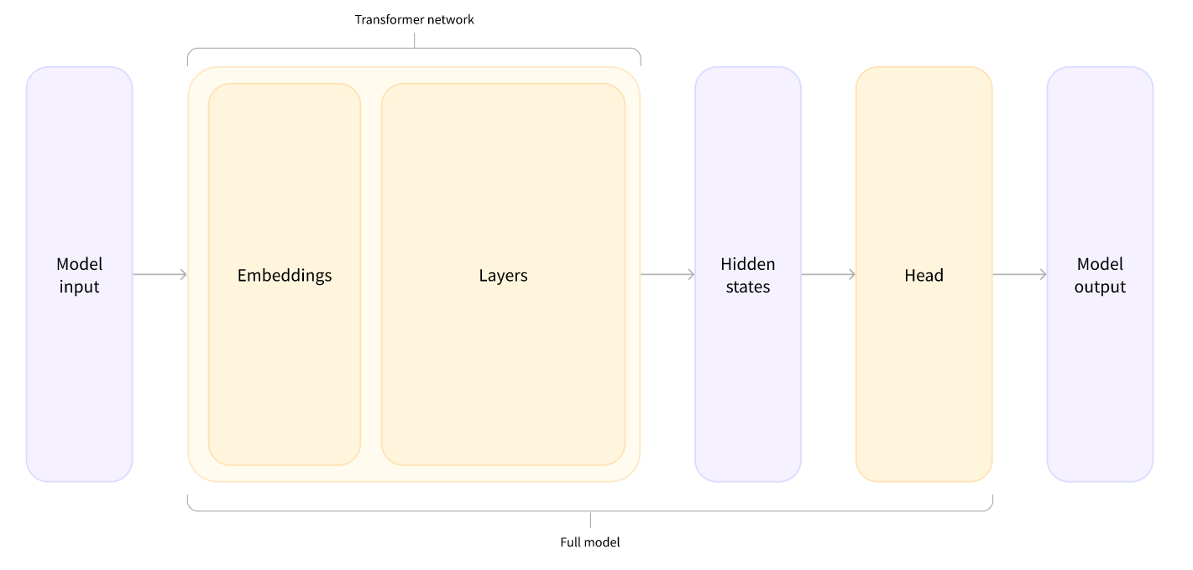
Zoomed-in View of Model

Slide 78
Hands-on Coding

Slide 79
LESSON 5

Slide 80
Weights and Biases

Slide 81
Weights & Biases
Why? It automates your record keeping!
W&B Docs | Weights & Biases Documentation (wandb.ai)
Intro_to_Weights_&_Biases.ipynb - Colaboratory (google.com)

Slide 82
Weights & Biases
Three calls to start logging!
wandb.init - Documentation
name – a label for your run
project – where you want to group your runs
entity – username (important for collaboration)
tags
notes
config – dictionary to store information about your run
wandb.config - Documentation
dictionary of tracked items
argparse compatible
wandb.log - Documentation – logging. This is the best part!

Slide 83
Weights & Biases
Create a Weights & Biases account
Create a project “basic-demo”
In terminal:
pip install wandb
wandb login → use API key from “User Settings” to login
1. Quickstart Demo from W&B
Quickstart Colab Demo from W&B
2. Integrate with Trainer object from Hugging Face
Modified Colab demo from last lecture
Guide from W&B
Notes:
Changes to rotten tomatoes classification trainer from lesson 4:
Removed zero-shot performance w/ confusion matrix
Removed saving
Removed second test

Slide 84
Hands-on Coding

Slide 85
Fill in the blank...
Virtually ALL machine learning techniques require lots of __________ to work well.
So... for a custom project, using custom data, how do we do that, exactly?

Slide 86

Labelling Data
Many techniques – but I recommend: https://labelstud.io/
Why?
Distributed labelling (more than 1 at a time)
Now hosted on ACI’s WIRE https://icsarl.westpoint.edu/wire
Versatile
Text? Sure.
Image? Sure.
Audio? Sure.
Let’s take it for a test drive!

Slide 87
Topic Modeling
Topic modeling is an unsupervised machine learning technique to reduce dimensionality of your corpus.*
Start with 1000 unique documents
Group / Cluster ones that are similar
Think PCA for text data
Two main techniques:
Lexical (LDA)
Transformer (BERTopic)
Let’s take this for a test drive on our course end feedback.
* An alternative to topic modeling is topic classification model (supervised)

Slide 88
Research Opportunities in D/Math!

Slide 89
Questions?

Slide 90
Additional Slides

Slide 91
Links
Old Demos
Colab Notebooks:
Fine-tuning a model in Google Colab [training]
Using a fine-tuned model in Google Colab
Hugging Face: Hugging Face – The AI community building the future.
NLP
CS287: Deep Learning for NLP is a course Jack took in grad school. It was only taught for one semester, but the lecture slides are all available online (for now) [link - scroll to "Lectures"]. There’s also a helpful Supplemental Resources page for NLP.
Hugging Face (particularly their Transformers library) is one of the most popular communities/platforms for NLP/AI/ML. They have great tutorials and readable documentation. Hugging Face models and datasets are designed to work well with and/or build on other popular NLP packages [nltk, AllenNLP, spacy].
Python
If you want to using Python without downloading it – Google Colab is a free online version of a Jupyter notebook with incredible functionality.
Jack uses VSCode as my IDE for Python.
Most individuals use the Anaconda Distribution for Windows. You can find instructions here: [link]
Jack paid ~$15 back in 2020 for a Udemy course called “Complete Python Bootcamp”. [link – the video to install Python is available as a free preview Python Setup>Installing Python (Step by Step)]. The course lecture slides and materials are freely available. [slides] [github repo w/ Jupyter Notebooks].
Google also has a free Python Course. [link]

Slide 92
…More Links
Sebastian Ruder [his site] [his Google Scholar] has a great blog that covers new ideas in NLP, NLP Progress, his highlights from NLP conferences…etc. In 2018 he gave a brief timeline of NLP. https://ruder.io/a-review-of-the-recent-history-of-nlp/.
If you want straightforward explanations of how the most used NLP models work, Jay Alammar has a blog with great visuals and explanations for word2vec (2013) and BERT (2018+) toward the bottom of his blog posts.

